Slide 1
DreamVue AI: Unveiling Your Subconscious

Slide 2
Agenda
Introduction
Problem Statement
Solution Overview
Features
User Interface
Technologies Used
Hackathon Contribution
Conclusion

Slide 3
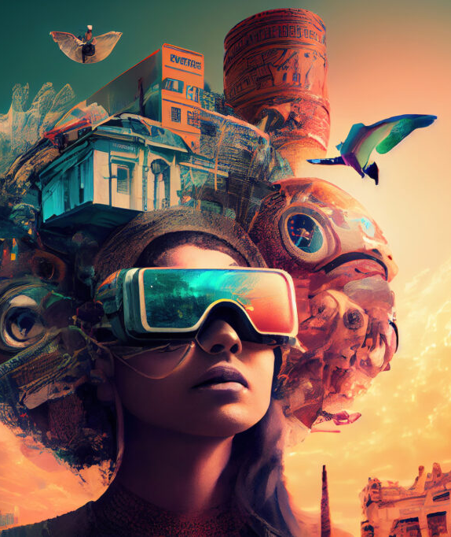
Introduction
DreamVue AI is an innovative venture designed to delve into the intricate realm of dreams. At its core, DreamVue AI aims to decode the mysteries of our subconscious minds by providing a sophisticated platform for the analysis of dreams, offering profound insights into the symbolism, themes, and underlying meanings embedded within each dream

Slide 4
Primary Purpose of DreamVue AI:
DreamVue AI employs GPT-4 Turbo, our advanced AI system, to meticulously analyze user-provided dream details.
Beyond mere analysis, DreamVue AI offers personalized insights tailored to individual dream patterns and emotional responses.
This not only aids in deciphering symbolic imagery but also adds a visually immersive layer, enriching the overall interpretative experience.

Slide 5
Problem Statement
Discuss the challenges people face in understanding their dreams

Slide 6
Discuss the challenges people face in understanding their dreams
People struggle to understand the complexities of their dreams, facing challenges in deciphering symbolism and emotions. The subjective nature of interpretations adds to the difficulty, creating a need for a reliable and systematic solution. Enter DreamVue AI, an innovative tool using advanced AI to provide consistent and insightful dream analysis, bridging the gap between subconscious experiences and conscious understanding

Slide 7
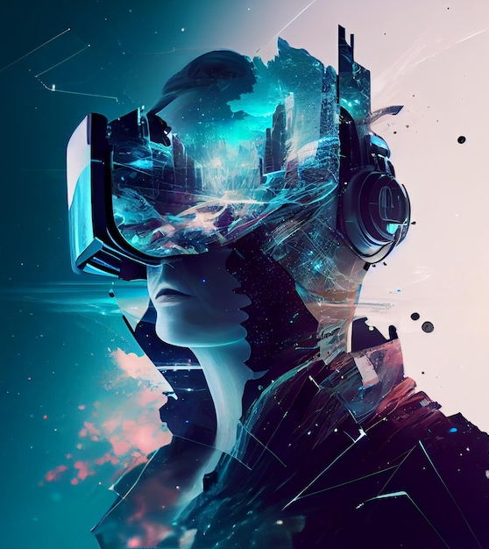
Solution Overview
DreamVue AI stands as an innovative solution, revolutionizing the field of dream interpretation with its cutting-edge capabilities. This comprehensive platform combines advanced AI technologies to offer users a transformative experience in understanding their dreams.

Slide 8
Technologies Used

Slide 9
Technologies Used:
DreamVue AI is powered by a robust technological stack, ensuring a seamless and efficient user experience. Our project leverages a combination of front-end and back-end technologies to bring dream interpretation to life.
Front-End Technologies:
HTML & CSS: The foundation of DreamVue AI's user interface, providing structure and styling for an intuitive design.
JavaScript (JS): Enhancing interactivity and functionality, JS adds dynamic elements to the user interface, contributing to a more engaging experience.
Tailwind CSS: Streamlining the styling process with a utility-first CSS framework, ensuring a responsive and visually appealing design.

Slide 10
Back-End Technology:
Flask: Serving as the backbone of DreamVue AI, Flask powers the server-side logic, handling user requests, and orchestrating seamless communication between the front-end and back-end.
This harmonious integration of front-end and back-end technologies is fundamental to the success of DreamVue AI, creating a cohesive and powerful platform for dream interpretation.

Slide 11
Features

Slide 12
Features:
Dream Analysis:
Our advanced AI, powered by GPT-4 Turbo, meticulously analyzes user-provided dream details, uncovering nuanced layers of symbolism and emotions within each dream.
Dream Journal:
Users can maintain a comprehensive dream journal within the app, recording experiences, tracking patterns, and fostering reflection for personal growth.
Community Sharing:
Connect with fellow dreamers through the community sharing feature, facilitating discussions, interpretations, and shared experiences for a deeper understanding of dreams.

Slide 13
User Interface
Experience the intuitive and user-friendly design of the DreamVue AI app interface. Our interface is crafted with simplicity and functionality in mind, ensuring users can seamlessly navigate through the app and make the most of its powerful features.

Slide 14
Highlights:
Intuitive Design:
Screenshots showcase a clean and intuitive design that prioritizes ease of use.
User-Friendly Navigation:
The app's navigation system is thoughtfully designed to provide a smooth and straightforward user experience.

Slide 15
Hackathon Contribution

Slide 16
Hackathon Contribution:
As participants in this hackathon, our contribution revolves around the development and implementation of DreamVue AI—an innovative solution at the intersection of AI and psychology. Our project stands out for several unique and innovative aspects that set it apart in the realm of dream interpretation.
Our contribution to this hackathon represents not only technical prowess but a commitment to addressing a real-world challenge through a creative and forward-thinking approach. DreamVue AI is not just a project; it's a testament to the potential of AI in unlocking the mysteries of the human mind.

Slide 17
Conclusion:
In conclusion, DreamVue AI stands as a groundbreaking venture in the field of dream interpretation, combining advanced AI technologies with a user-centric design. Throughout this presentation, we explored the key features and innovative aspects that make DreamVue AI a transformative tool for understanding the complexities of our dreams.
Impact and Significance:
DreamVue AI not only addresses the challenges associated with understanding dreams but also opens new avenues for personal growth and community engagement. By harnessing the capabilities of AI, DreamVue AI empowers individuals to unravel the mysteries of their subconscious minds, fostering a deeper connection with their dreams and ultimately contributing to a greater understanding of the human psyche.
In essence, DreamVue AI is not just a tool for dream interpretation; it's a catalyst for exploration, self-discovery, and meaningful connections within the realm of our dreams.

Slide 18
Thank you

